Slide 1
Metaheuristic Approaches for
Solving the Fixed-Charge Capacitated Multi-commodity Network Design Problem
Michel Gendreau
CIRRELT and DIRO
Université de Montréal
DEIS, Universita degli studi di Bologna
Bologna − June 6, 2008

Slide 2
With the help of …
Teodor Gabriel Crainic
Judy Farvolden
Ilfat Ghamlouche
Geneviève Hernu
And several others…

Slide 3
Outline
Network design
  Definitions, formulations, the need for heuristics
Early Heuristics
Path-based Tabu Search
Cycle-based Tabu Search
Path Relinking
Scatter Search
Conclusion

Slide 4
Network Design
Given
  Network
    Existing + possible additions
    Cost structure
    Capacities
  Demands
Determine what part of the possible network to include to satisfy demand at minimum total cost.

Slide 5
Network Design Problems
Decisions on adding
  Nodes: Location
  Arcs: Network design
  Capacity: Network dimensioning, …
Cost structure
  Fixed costs (to install/open/offer/use …)
  Variable costs (to operate)
  Budget constraints, …
Single or multi-commodity
Capacitated or not, …

Slide 6
Network Design Problems
Decisions on adding
  Nodes: Location
  Arcs: Network design
  Capacity: Network dimensioning, …
Cost structure
  Fixed costs (to install/open/offer/use …)
  Variable costs (to operate)
  Budget constraints, …
Single or multi-commodity
Capacitated or not, …

Slide 7
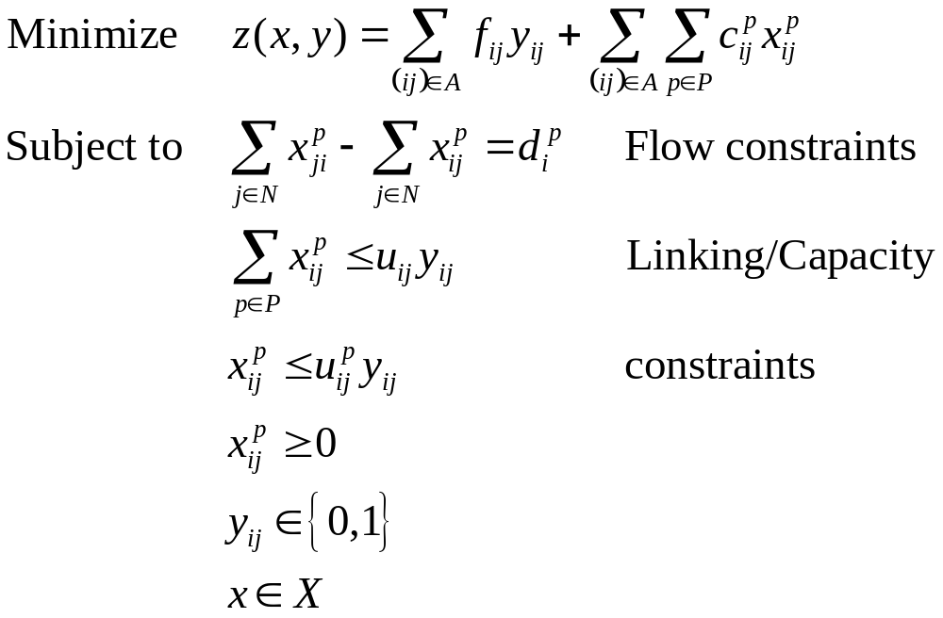
Linear Arc-based Formulation

Slide 8
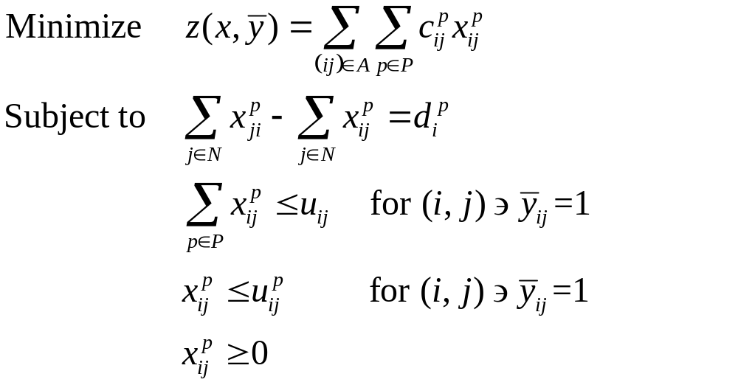
Flow Subproblem for given y

Slide 9
Flow Subproblem for given y
Capacitated, multi-commodity network flow problem!

Slide 10
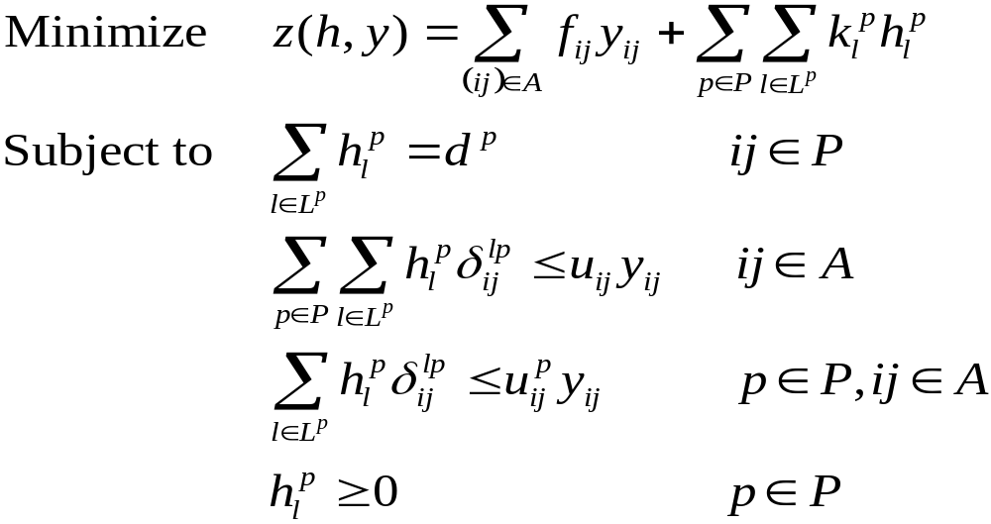
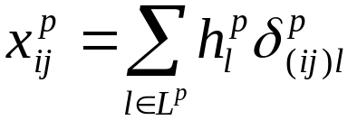
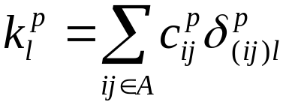
Linear Path-based Formulation

Slide 11
Difficult Problems
Fixed costs ↔ Capacities
Multiple commodity paths
Difficult (and degenerate) flow subproblems
Large dimensions
Large instances must be solved with heuristics

Slide 12
Early Heuristics
Classical heuristics
  Greedy approaches
  “Add/drop” approaches
  Arc swaps
    Good for location, bad for design!
We must come up with better ideas…

Slide 13
Tabu Search
Proposed by Glover (1986), it is one of the most effective metaheuristics.
TS can be seen as a generalization/extension of classical local search (improvement) methods :
  A “current” solution is slowly modified with the goal of ultimately finding a very good solution.
  The value of the objective function is allow to degrade to escape local optima.
  Short-term memory mechanisms prevent cycling.
  Longer-term memories are used to guide the search in the solution space.

Slide 14
Tabu Search Template
Build an initial solution
Local search
  Find the best non-tabu solution in the neighborhood of the current solution
  Update
    Best known solution and value (if appropriate)
    Short, medium and long-term memories
  Check the stopping criterion: go to a or 3
Intensification
Diversification

Slide 15
Tabu Search Key Features (1)
Intensification:
  A more thorough exploration of areas of the search space that have been identified as “promising”.
  Usually based on medium-term memories, e.g., recency memory.
  Often involves “freezing” some components of the solution.

Slide 16
Tabu Search Key Features (2)
Diversification:
  A forced move to unexplored areas of the search space.
  Usually based on long-term memories, e.g., frequency memory.
  May be implemented as a separate phase or in a continuous fashion.
  In many implementations, the most important feature besides the basic local search.

Slide 17
Failed Tabu Search Approach
Applying TS with “add/drop” or “swap” neighborhoods.
These neighborhoods are too limited to lead to a purposeful local search of the solution space.
Even TS cannot help here!

Slide 18
Path-based Tabu Search (1)
Crainic, Gendreau and Farvolden (2000)
Approach based on a fixed cost vision of the problem.
The key variables are the commodity flow variables; the design variables are simply obtained from flow variables.
The neighborhood used relies on the path-based formulation of the problem.
Local search moves correspond to pivots in the path-based formulation of the multi-commodity network flow problem in which all arcs are open.
Fixed costs of arcs with positive flow are added to the cost of the solution.

Slide 19
Path-based Tabu Search (2)
To avoid having to consider all possible paths, column generation is used to create the path flow variables.
  Column generation is invoked only when a local optimum w.r.t. to the paths already generated.
  Fixed costs are linearized when solving the column generation subproblem.
Tabus are implemented by forbidding paths that have exited the basis to go back into it for a random number of iterations.
Diversification is invoked after a set number of column generation phases without improvement of the objective.
Diversification is induced by closing a small subset of often-used arcs for some time.

Slide 20
Path-based Tabu Search (3)
The method was tested on sets of instances having:
  between 20 and 100 nodes,
  between 100 and 700 arcs,
  between 10 and 400 commodities,
  different fixed to variable costs ratios;
  loose or tight capacity constraints.
Overall assessment:
  The method worked fine and was at the time the best available one by far, but some questions remained with respect to its performance on the larger instances…

Slide 21
Cycle-based Tabu Search (1)
The path-based TS had some limitations:
  The way the neighborhood was defined implied that we only considered flow modifications of a single commodity at the time.
  Too myopic for instances with several commodities.
New neighborhood structures were required.
We went back to a search based on design variables (y) → these variables completely define a solution, if one solves the associated minimum cost flow problem.
Paper by Ghamlouche, Crainic and Gendreau (2003)

Slide 22
Cycle-based Neighborhood
In a network design problem, in order to significantly modify a solution, one must be able to open and close sequences of arcs that make up subpaths.
Flow movements take place along cycles in the residual graph.
The new neighborhood is based on the identification of cycles in residual graphs of a given capacities.
This allows for significant modifications of the current solution at each iteration:
  several arcs / several products simultaneously.

Slide 23
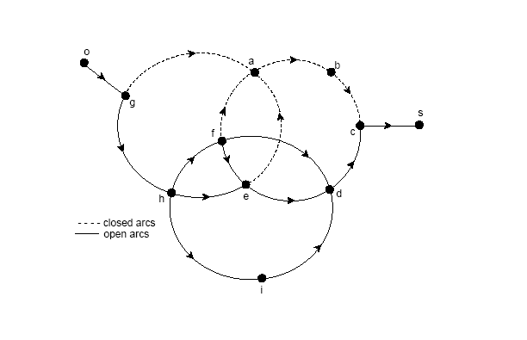
Cycles

Slide 24
Cycle-based Tabu Search (2)
At each iteration, the cycle-based neighborhood is partially examined by considering sets of candidates arcs as starting points for creating cycles.
A labeling heuristic is used to identify low cost cycles containing a given arc.
For each solution, once the cycle has been identified, the flow pattern is adjusted by solving exactly the associated MCNF problem.
  Infeasible solutions may be found because commodities are aggregated in the determination of the best cycle → restoration might be needed.
Fairly simple search strategy:
  Intensification is invoked when very good solutions are obtained.
  Implemented by modifying the flows of individual commodities.
  Simple stopping criteria (elapsed CPU time or number of iterations)

Slide 25
Cycle-based Tabu Search (3)
The method was tested on the same sets of instances as the path-based TS.
The cycle-based TS outperformed the path-based one on 34 out of 43 instances:
  Path-based was better only on 9 of the smaller, “easy” instances that can be solved optimally using B&B.
  The optimality gap on instances with high fixed costs was reduced dramatically.

Slide 26
Path Relinking
Another technique proposed by Glover.
Basic idea:
  explore in the solution space trajectories that link good known solutions with the objective of finding even better ones (intensification concept).
The “good” (or “elite”) solutions to be provided must be provided by some other method.
Compromise between the quality and the diversity of the solutions considered.

Slide 27
Path Relinking for Network Design (1)
Paper by Ghamlouche, Crainic and Gendreau (2004).
Implementation based on the cycle-based TS.
We tested several strategies for building the reference set of solutions to be considered and for selecting the initial and guiding the initial and the guiding solutions of trajectories.
Trajectories are explored using the one-commodity-at-the-time variant of the cycle-based neighborhood.

Slide 28
Path Relinking for Network Design (2)
Tested on the same instances as the other methods.
Excellent results:
  Path relinking improves the best solutions found by the cycle-based method for 37 instances out of 41!
  Probably the best heuristic currently available for the capacitated, multi-commodity network design problem.

Slide 29
Path Relinking for Network Design
Paper by Ghamlouche, Crainic and Gendreau (2004).
Implementation based on the cycle-based TS.
We tested several strategies for building the reference set of solutions to be considered and for selecting the initial and guiding the initial and the guiding solutions of trajectories.
Trajectories are explored using the one-commodity-at-the-time variant of the cycle-based neighborhood.

Slide 30
Scatter Search
Yet another technique proposed by Glover (1977) for combining good known solutions for a problem.
Basic idea:
  linearly combine vectors describing solutions.
We want to explore the space of the (binary) design variables → How can this concept be applied?!?

Slide 31
Scatter Search Template
Generate an initial population of diverse and good solutions.
Select a subset = Reference Set (RS).
Extract L solutions from RS = Candidate Set (CS).
Create new solutions by combining solutions in CS
  → Feasibility!
Improve the new solutions.
Update the Reference Set.

Slide 32
Scatter Search for Network Design
Paper by Crainic and Gendreau (2007)
We want to explore the space of the (binary) design variables
→ How can we apply the basic SS concepts ?!?
We combine solutions by rounding some variables and fixing them to set values and letting others be free.

Slide 33
Initialization
Initial population
  Solutions generated by Cycle-based tabu search
Reference Set initialized with improving local optima, i.e., local optima better than solutions already in RS.
Candidate sets
  Best solution in RS
  The solution farthest away from it (Hamming distance)
  Randomly selected solutions

Slide 34
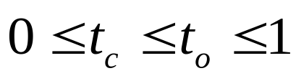
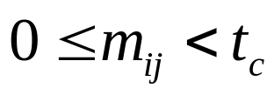
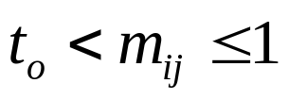
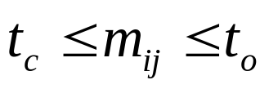
Creating a Solution (2)
Two thresholds are associated with arc selection
In the new solution
  Close arc (i,j) when
  Open arc (i,j) when
  Arc (i,j) is undecided when

Slide 35
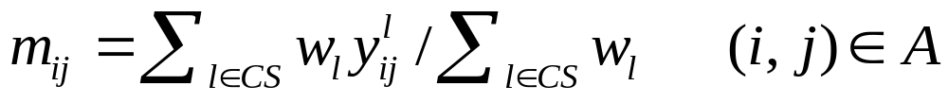
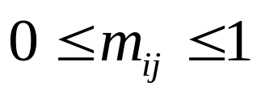
Creating a Solution
L solutions in a Candidate Set.
Compute a desirability factor for arc (i, j) as
The weights w_{l} are particular to each mechanism.

Slide 36
Combination Mechanisms
Voting (V): w_{l} = 1 for all l
Distance (H): w_{l} = 1 / (Hamming distance between solution l and best solution)
Cost (C): w_{l} = 1 / (cost difference between solution l and best solution)
Frequency (F): w_{l} = frequency of arc (i,j) in best solutions

Slide 37
Processing a Solution
The incomplete solution obtained from the combination operation is first sent to CPLEX with:
  Closed arcs are given a 0 capacity.
  Undecided arcs are given a f_{ij}/u_{ij}+c_{ij} variable cost.
TabuCycle is launched from the resulting solution
  The procedure includes a mending phase for unfeasible solutions.
  An intensification phase (moves involving a single commodity) may be called from the resulting solution before starting the tabu search proper.

Slide 38
Preliminary Computational Testing
Tests conducted on a small (10) subset of problems.
Experiment with 2 different values for t_{c} and t_{o}
  t_{c} = 0.25, t_{o}= 0.75
  t_{c} = 0.40, t_{o}= 0.60

Slide 39
Preliminary Computational Testing
Tests conducted on a small (10) subset of problems.
Experiment with 2 different values for t_{c} and t_{o}
  t_{c} = 0.25, t_{o}= 0.75
  t_{c} = 0.40, t_{o}= 0.60
All further experiments ran with these values.

Slide 40
Experiments
Set of 43 problem instances
  20 to 100 nodes
  100 to 700 arcs
  Different fixed to variable cost ratios
  Different capacity to demand ratios
Test the
  Four combination mechanisms
  Four Candidate Set cardinality values = 2,3,4,5
  Intensify or not at the start of TabuCycle
  Different sizes for the Reference Set
Same tabu search parameters used for path relinking.

Slide 41
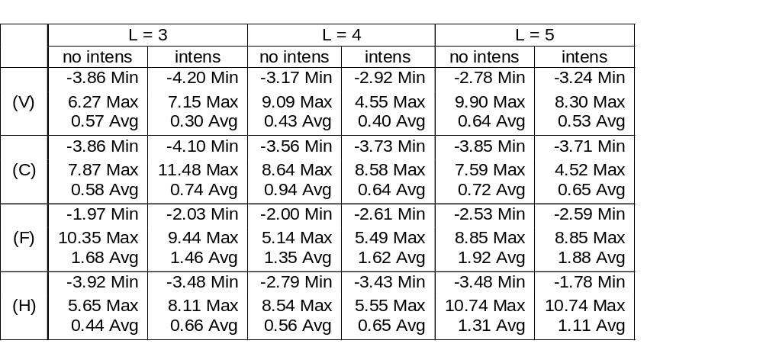
Comparisons to Path Relinking (Gaps in %)

Slide 42
Results
Results with L = 2 are not competitive.
Results obtained with less than 20 elements in the reference set are significantly poorer.

Slide 43
Discussion
All combinations are capable of producing solutions better than those obtained with Path Relinking on some instances.
On average, no combination can beat PR, but the best ones are getting close.
Difficult to discriminate between inclusion or not of Intensification phase; since it requires computing effort, one may eventually abandon it.
It seems that L = 3 or 4 is sufficient.

Slide 44
Conclusion
We have a large set of approaches for tackling network design problems.
The best one currently is probably Path Relinking, but one might possibly be able to still improve upon it.
Future work: attack stochastic network design problems.

